Slide 1
Introduction to Machine Learning
Overview – Design of a Learning System
Types of Machine Learning
Supervised Learning and Unsupervised Learning
Mathematical Foundations of Machine Learning
Applications of Machine Learning , Machine Learning Foundations

Slide 2
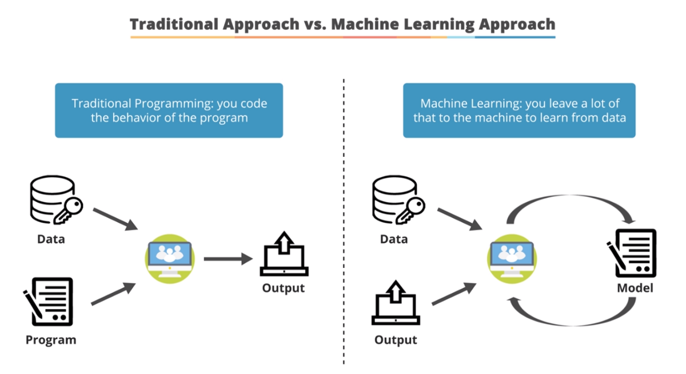
Traditional Programming Vs Machine Learning
Traditional Programming refers to any manually created program that uses input data and runs on a computer to produce the output.
In Machine Learning, also known as augmented analytics, the input data and output are fed to an algorithm to create a program. This yields powerful insights that can be used to predict future outcomes.

Slide 3
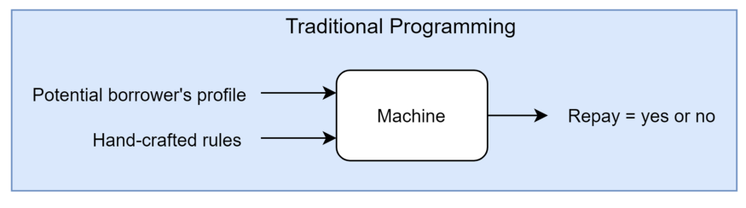
Traditional Programming Vs Machine Learning Example
Credit Risk Estimation: Our goal is to automatically evaluate the risk that a potential borrower will pay a loan or not.
Traditional Approach
Eg. If income > 150k AND saving > 200k, then Repay = Yes
Eg. If income < 150k AND saving < 200k, then Repay = No

Slide 4
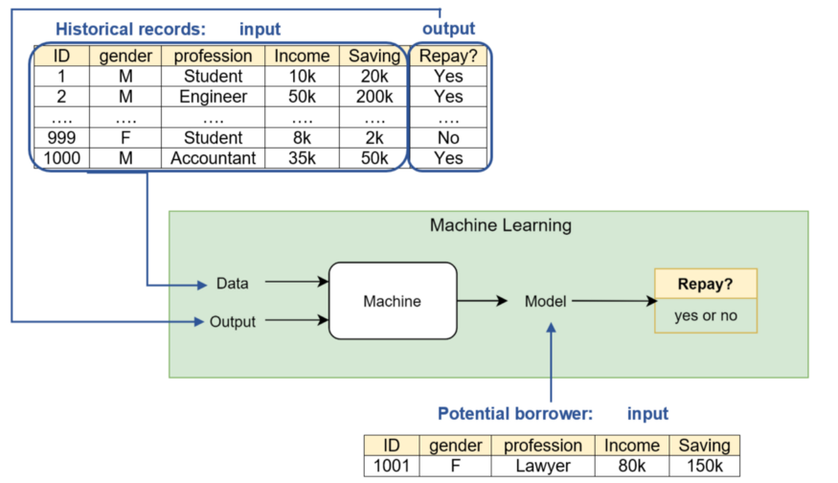
Traditional Programming Vs Machine Learning Example
Credit Risk Estimation: Our goal is to automatically evaluate the risk that a potential borrower will pay a loan or not.
ML approach

Slide 5
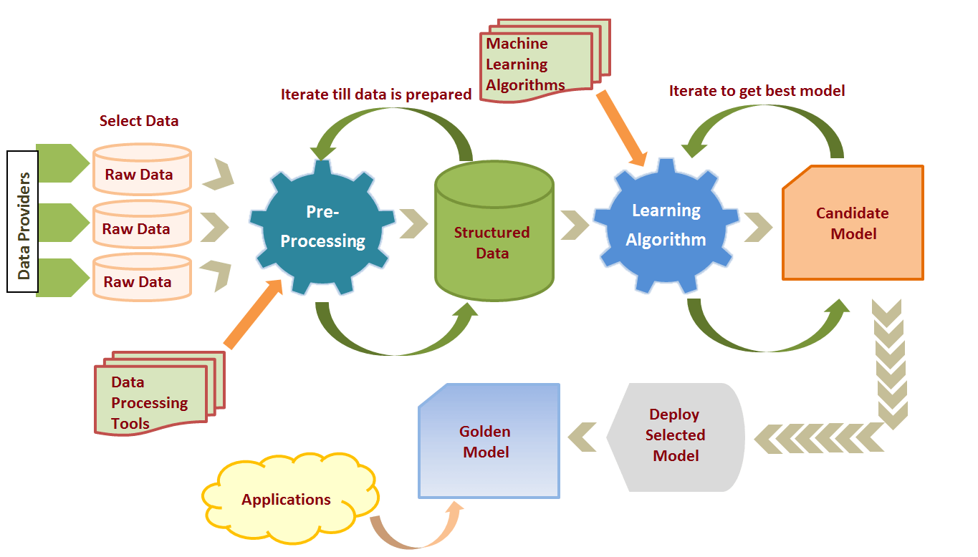
Machine Learning Process

Slide 6
Machine Learning Process
1.Data Preparation and Data Pre-processing
Data preprocessing is a process of preparing the raw data and making it suitable for a machine learning model.
It includes Data Integration , Data transformation , Data Cleaning and data reduction
2. Model selection
There are many models that researchers and data scientists have created over the years.
Some are very well suited for image data, others for sequences (like text, or music), some for numerical data, others for text-based data.
Model selection in machine learning refers to the process of choosing the best model from a set of candidate models for a specific task or problem

Slide 7
3. Training
In this phase we use data sets to incrementally improve model’s ability.
Training data set
Is the data set on which model is trained
Train data set is data set from which the model has learned the experiences.
Training sets are used to fit and tune models.
Test data set
Test data is the data that is used to check if the model has learned good enough from the experiences it got in the train data set.
Test sets are “unseen” data to evaluate your models.

Slide 9
4. Evaluation
Evaluation allows us to test our model against data that has never been used for training.
5. Model Deployment
Deployment of an ML-model simply means the integration of the finalized model into a production environment and getting results to make business decisions.

Slide 10
Revise
1. Explain steps of machine learning process
2. Define the terms training data and testing data
3. Compare traditional programming and machine learning

Slide 11
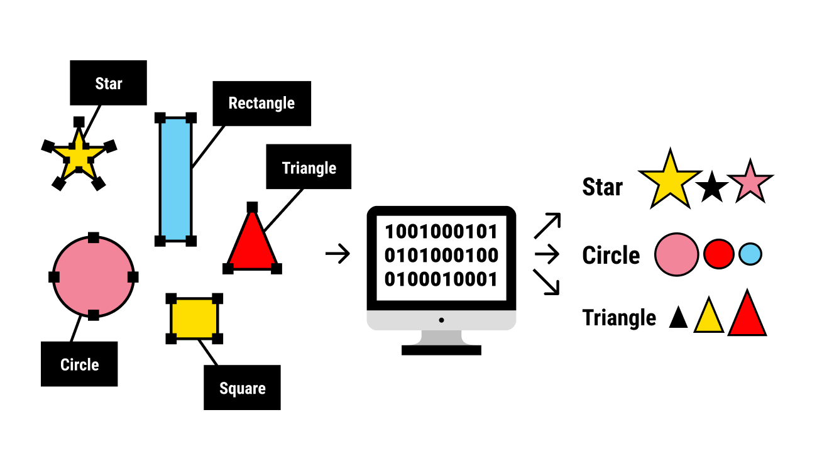
Terms used in types of machine learning
1.Labeled Data
Data consisting of a set of training examples, where each example is a pair consisting of an input and a desired output value
Ex.
1.
Data set shown in the image is labeled
data set. Every image is labeled by its shape
Input Output

Slide 12
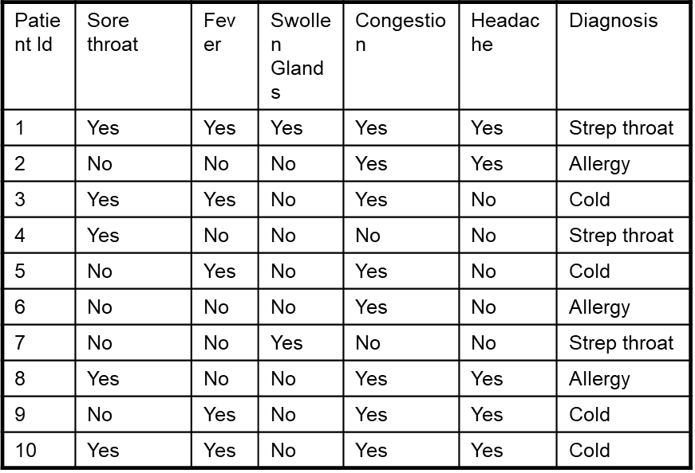
Ex.
2.
Data set shown in the image is labeled
data set. Every record is labeled with
the value for diagnosis.
Labels(output) here are , Strep Throat, allergy or cold
Output
Input

Slide 13
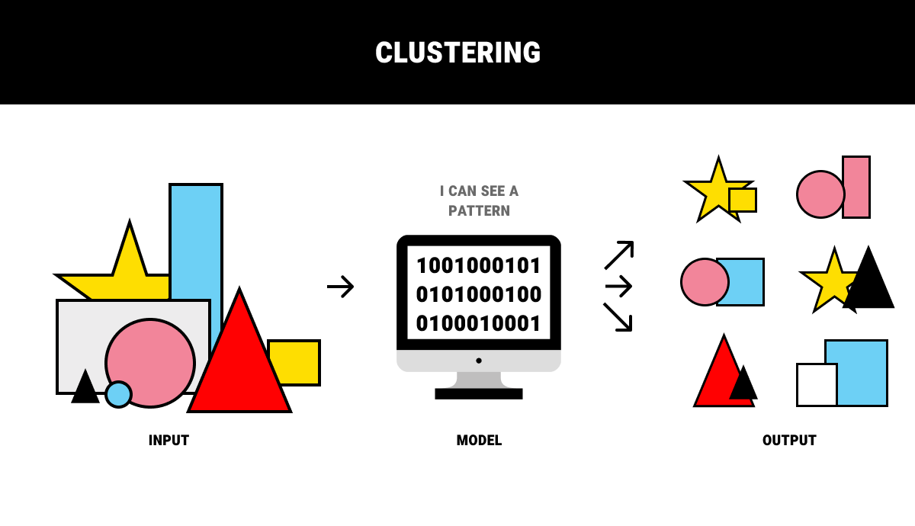
2.Unabled Data
Unlabeled data doesn’t have any meaningful tags or labels .
Ex.
1.
Data set shown in the image is unlabeled data set. shape.

Slide 14
Ex.
2.
Data set shown in the image is Unlabeled
data set.
Input

Slide 15
Types of machine Learning
Supervised learning
Supervised learning is the types of machine learning In which machine learning algorithms are feed with the well labeled data.ie. Input and its associated output.
From the labeled data algorithms should be able to learn the patterns
Supervised learning algorithms try to model relationships and dependencies between the target prediction output and the input features
And then we can predict the output values for new data based on those relationships which it learned from the previous data sets.
Are the family of algorithms that which are mainly used in classification and prediction

Slide 16
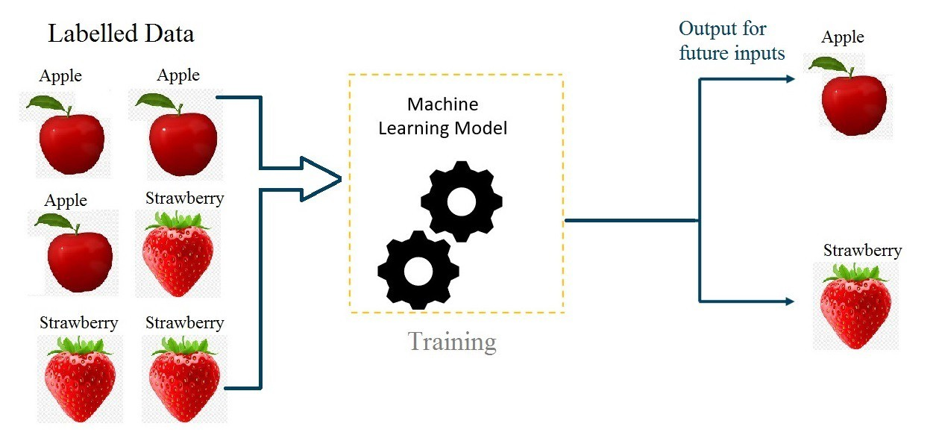
Supervised learning

Slide 17
Types of machine Learning
2. Unsupervised learning
Unsupervised learning is a category of machine learning in which we only have the input data to feed to the machine learning algorithm but no corresponding output
Algorithm learns the patterns based on the similarity between input data instances .
Are the family of algorithms that which are mainly used pattern detection and descriptive modeling
These algorithms try to use techniques on the input data to mine for rules, detect patterns, and summarize and group the data points which help in deriving meaningful insights and describe the data better to the users.

Slide 18
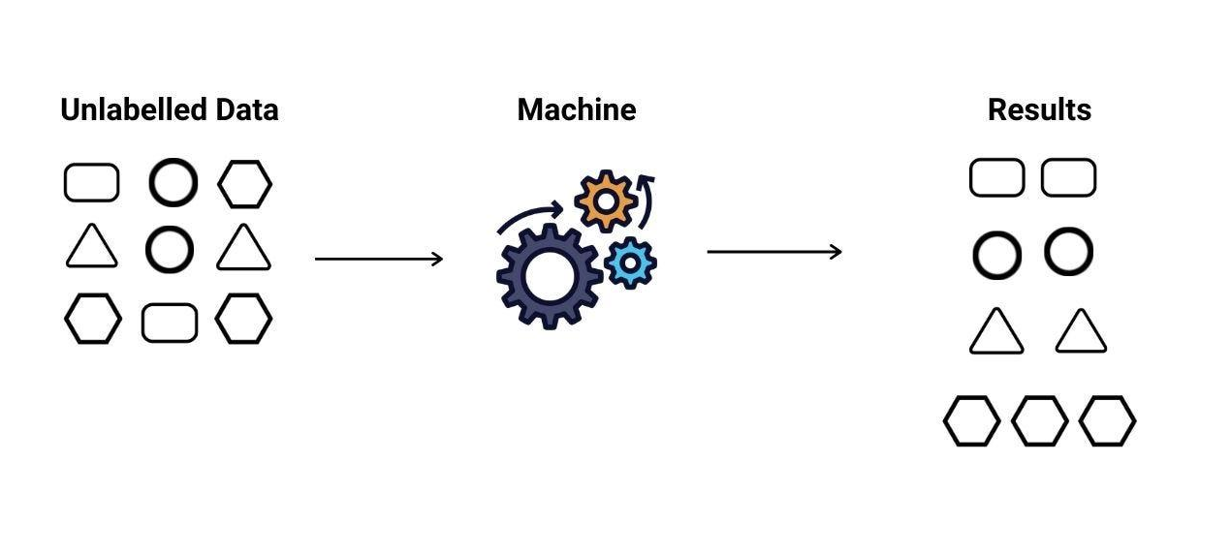
Unsupervised learning

Slide 19
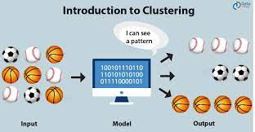
Unsupervised learning

Slide 20
Revise
Explain the terms Labeled data and unlabeled data
Explain supervised learning
Explain unsupervised learning

Slide 21
Machine Learning Foundations

Slide 22
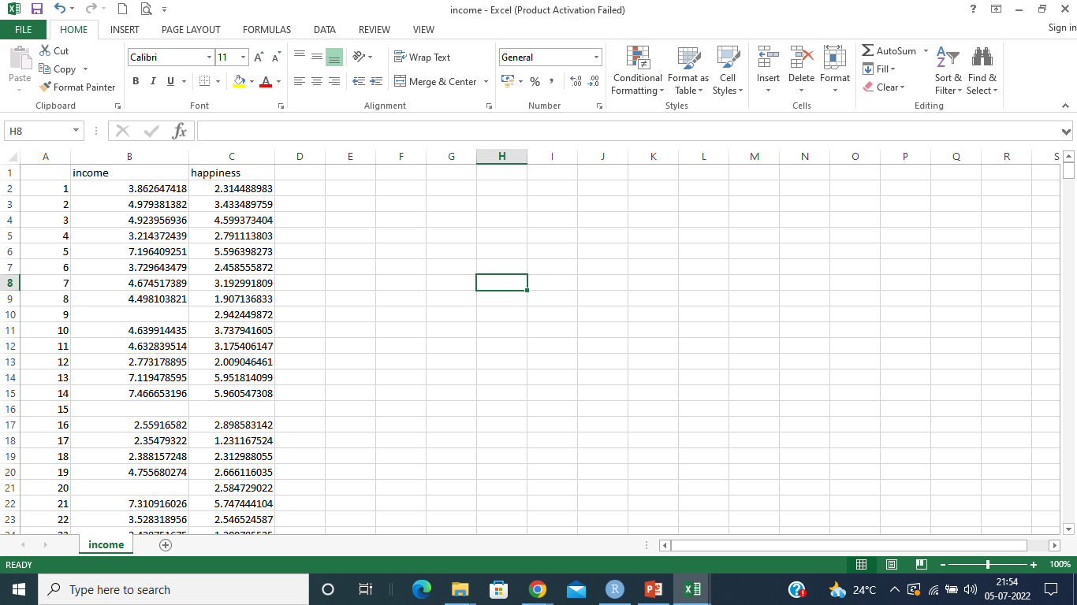
Data Sets
Explanatory variable/independent variable
subject identifier
Outcome Variable/dependent variable
one row per experimental subject

Slide 23
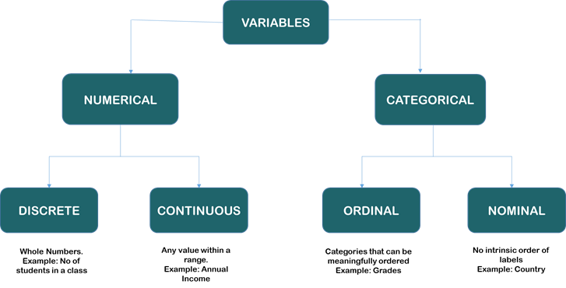
Attribute types

Slide 24
Measures of central tenancy
Mean
Centre of data set, can be obtained using a built in aggregation function avg in SQL
can be computed using some algebraic function on one or more distributive measures
mean() = sum() /count()
It is a distributive measure – can be computed parallelly on partitions
It is extremely sensitive – Even a small amount of extreme values can corrupt the mean
Trimmed mean can be obtained by chopping extreme values

Slide 25
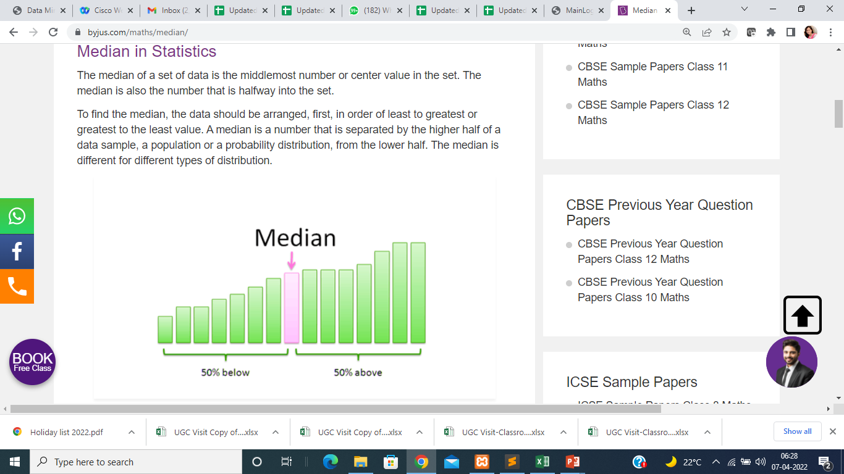
Measures of central tenancy
Median
Center of data set, It is the middle value of the ordered set(if n is odd) or average of two middle values(if n is even)
It need to be computed on the entire data set as a whole
It is not a distributive measure- It cannot be computed by partitioning the data and parallely computing on each partition
It is computationally expensive – sorting entire data
It is less sensitive to extreme values
Ex. (Even number of values ) : The median of 3, 3, 5, 9, 11 is 5. If there is an even number of observations, then there is no single middle value; the median is then usually defined to be the mean of the two middle values: so the median of 3, 5, 7, 9 is (5+7)/2 = 6.

Slide 26
Measures of central tenancy
Mode
The mode is the value that appears most frequently in a data set.
Ex. 3, 3, 6, 9, 16, 16, 16, 27, 27, 37, 48
Mode for above data is 16
We can have more than one mode in data. Ex. 3, 3, 3, 9, 16, 16, 16, 27, 37, 48
Data sets can be unimodal, bimodal , trimodal etc, Multimodal data sets have two or more modes
The mode is not affected by extreme values.

Slide 27
Missing Values
In data pre-processing, it is important to identify and correctly handle the missing values
To deal with missing values one can either
Remove the records with missing values
Missing values can be replaced by calculated statistical measures i.e. Mean,Median and Mode

Slide 28
What is Feature Scaling ?
Machine learning algorithm works on numbers and has no knowledge of what that number represents.
It is a method to standardize the independent variables of a dataset within a specific range.
Feature Scaling is one of the important pre-processing that is required or standardizing/normalization of the input data.
When the range of values are very distinct in each column, we need to scale them to the common level.

Slide 29
Standardization & Normalization
Machine learning algorithm works on numbers and has no knowledge of what that number represents.
It is a method to standardize the independent variables of a dataset within a specific range.
Feature Scaling is one of the important pre-processing that is required or standardizing/normalization of the input data.
When the range of values are very distinct in each column, we need to scale them to the common level.

Slide 30
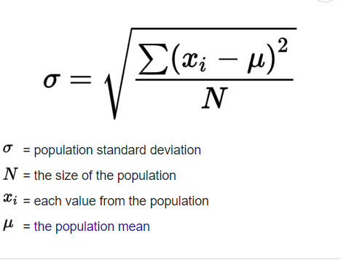
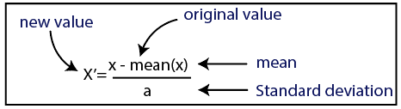
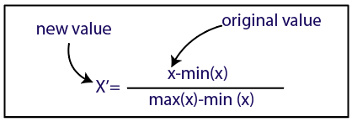
Standardization & Normalization
Standard Deviation

Slide 31
Encoding Categorical Data
Most of the Machine learning algorithms can not handle categorical variables unless we convert them to numerical values.
There are many ways we can encode these categorical variables as numbers and use them in an algorithm.
Ex. 1. Label/Ordinal Encoding
2. One Hot Encoding

Slide 32
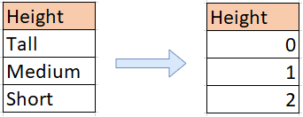
Encoding Categorical Data
Label/Ordinal Encoding
This type of encoding is used when the variables in the data are ordinal.
Label encoding converts each label into integer values and the encoded data represents the sequence of labels.
Ex.

Slide 33
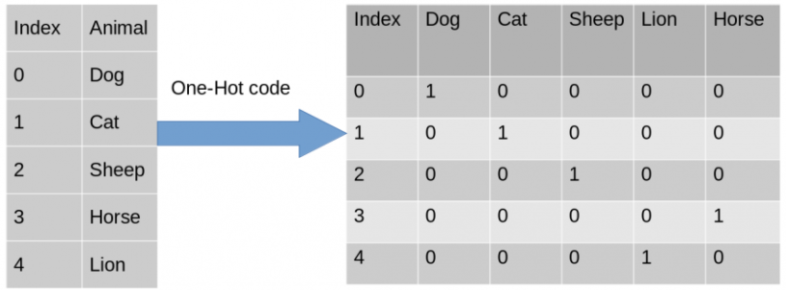
Encoding Categorical Data
One Hot Encoding
In One-Hot Encoding, each category of any categorical variable gets a new variable.
It maps each category with binary numbers (0 or 1).
This type of encoding is used when the data is nominal. Newly created binary features can be considered dummy variables.
After one hot encoding, the number of dummy variables depends on the number of categories presented in the data.
Ex.

Slide 34
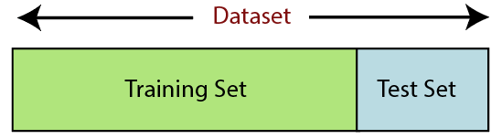
Splitting the dataset into training dataset and testing dataset
The train-test split is a technique for evaluating the performance of a machine learning algorithm.
It can be used for classification or regression problems and can be used for any supervised learning algorithm.
The procedure involves taking a dataset and dividing it into two subsets.
Train Dataset: Used to fit the machine learning model.
Test Dataset: Used to evaluate the fit machine learning model.

Slide 35
Applications of machine Learning
1. Image Recognition
Image recognition is one of the most common applications of machine learning. It is used to identify objects, persons, places, digital image
2. Speech Recognition
Speech recognition is a process of converting voice instructions into text, and it is also known as "Speech to text", or "Computer speech recognition."
3. Product recommendations
Machine learning is widely used by various e-commerce and entertainment companies such as Amazon, Netflix, etc., for product recommendation to the user.

Slide 36
Applications of machine Learning
4. Self-driving cars
It is using unsupervised learning method to train the car models to detect people and objects while driving.
5. Email Spam and Malware Filtering
Whenever we receive a new email, it is filtered automatically as important, normal, and spam. We always receive an important mail in our inbox with the important symbol and spam emails in our spam box, and the technology behind this is Machine learning.
6. Medical Diagnosis
In medical science, machine learning is used for diseases diagnoses.
7.online Fraud Detection
Machine learning is making our online transaction safe and secure by detecting fraud transaction.

